Slide 1
Travel Company’s Call Management Centre
Chris, Daniel, Sarah & Vishaal

Slide 2
Agenda
Problem definition
Design Thinking
Workproducts, models and descriptions
Competitive advantages and effects of project failure
Use of Agile and Scrum
Notes:
In today’s video, we will be discussing the…...

Slide 3

Section 1: Problem Definition

Slide 4
Objectives
Improve operation of their call management centre system
Respond to stakeholder needs
Objectives
Develop comprehensive diagrams
Discover competitive advantages and effects of failure
Notes:
1. To create an innovative yet technologically feasible Call
Management Centre product
2. To create a product that will embody the desires of all stakeholders involved
within the upgrade of the Call Management Centre
3. Develop many features that are desired by the client so they are able to have many options to choose from
4. To develop comprehensive diagrams for the client so they are able to understand the flow of data and methods
5. To show the client the competitive advantage they may achieve as a result of the developed product and to warn them of potential impacts of failure
7. To develop the product using an Agile process

Slide 5



RMs receive a commision based income
RMs are expected to learn outside their specialist knowledge
Competing travel companies have an advanced CMC
Assumptions
Travel Company is experiencing loss of sales, customer and employee dissatisfaction
Airline Companies form partnerships with the Travel Company to sell Holiday Packages
Notes:
As part of this project, the travel company had identified that they wouild liek to develop an informaiton system to improve the operation for their in house call management cretre to adjust the call flow rate. They believe that this would allow the customers that call the travel company to be connected to RMs that have speiclaist knowledge on the customer’s preferred travel destinaiton, enabling a greater utilisation of the RM’s knowledge and icnrease the possibility to make sales and profit amid their current tainted repuation.
The assumptions made about the travel company include that competing travel companies have an advanced CMC which enables customers to be connected to RMs that can cater their request. RM’s also have been pressured to learn outside their specialist knowledge due to being connected with customer’s who enquire about holiday packages they were not familar with. Airline companies also form partnerships with the travel company to sell holiday packages and the holiday packages offered by the travel company are only holidays that involve airlines as a form of transport. RMs also receive a commision based income which is based on the number of holiday packages they sell. Lastly, the travel company is experienving a loss of sales and customer and employee dissatisfaciton .

Slide 6
Project Stakeholders
Travel Company
Relationship Managers
Customers
Developers
System Admin
Airline Companies
Our project stakeholders included:
Notes:
The stakeholders involve the following:

Slide 7

Empathy Maps
Travel Company employee dissatisfaction
Partnerships between the Travel Company and Airline Companies in jeopardy
Unrealistic management expectations
Lower levels of sales in the Travel Company compared to competitors
An outdated CMC
Frustrated and unhappy customers
Notes:
To properly identify and define the problem, empathy maps were created by the group for each stakeholder through interviewing each stakeholder. The empathy map enabled us to gain a knowledge on what each stakeholder is thinking, feeling, saying, hearing, doing and seeing in regards to the call management centre system and travel company operations in general. Through empathy mapping, we were able to find that employees such as RMs, developers and system admin were experiencing high levels of employee dissatisfaction due to overwhelming pressure from frustrated customers, unrealistic management expectations due to pressures to learn the whole product and develop and manage code to improve the operations and a scared that they might lose their jobs if the travel company constantly loses profits. The Airlines Companies are also reconsidering their partnerships with the travel company due to them noticing a low customers utitlising the holiday packages that were created in conjunction with the travel company compared to competing travel companies. Customers are feeling unhappy and frustrated when they are put on hold and when RMs are unable to respond to their requests and being transferred.
From the empathy maps, we were able to create actional goals using POV statements, which involves a statement that defines a user, what they need and the insight. Through feeling what our stakeholders are feeling we found out that the CMC is outdated, causing a loss of customers and employees, cuasing unhappy and frustrated customers and not profiting airline companies. Hence, we uncovered that the CMC required a msssive overhaul for the survival of the travel company which lead to the ideation stage which sarah will go through.

Slide 8

POV statements
Point of View Statements uncovered insights regarding the call management centre, mainly:
It’s outdated
Causing unhappy and frustrated customers
Current operation not profiting partner airlines
Causing a loss of customers and employees
A new CMC would require constant maintenance
Notes:
To properly identify and define the problem, empathy maps were created by the group for each stakeholder through interviewing each stakeholder. The empathy map enabled us to gain a knowledge on what each stakeholder is thinking, feeling, saying, hearing, doing and seeing in regards to the call management centre system and travel company operations in general. Through empathy mapping, we were able to find that employees such as RMs, developers and system admin were experiencing high levels of employee dissatisfaction due to overwhelming pressure from frustrated customers, unrealistic management expectations due to pressures to learn the whole product and develop and manage code to improve the operations and a scared that they might lose their jobs if the travel company constantly loses profits. The Airlines Companies are also reconsidering their partnerships with the travel company due to them noticing a low customers utitlising the holiday packages that were created in conjunction with the travel company compared to competing travel companies. Customers are feeling unhappy and frustrated when they are put on hold and when RMs are unable to respond to their requests and being transferred.
From the empathy maps, we were able to create actional goals using POV statements, which involves a statement that defines a user, what they need and the insight. Through feeling what our stakeholders are feeling we found out that the CMC is outdated, causing a loss of customers and employees, cuasing unhappy and frustrated customers and not profiting airline companies. Hence, we uncovered that the CMC required a msssive overhaul for the survival of the travel company which lead to the ideation stage which sarah will go through.

Slide 9

Section 2: Ideation

Slide 10

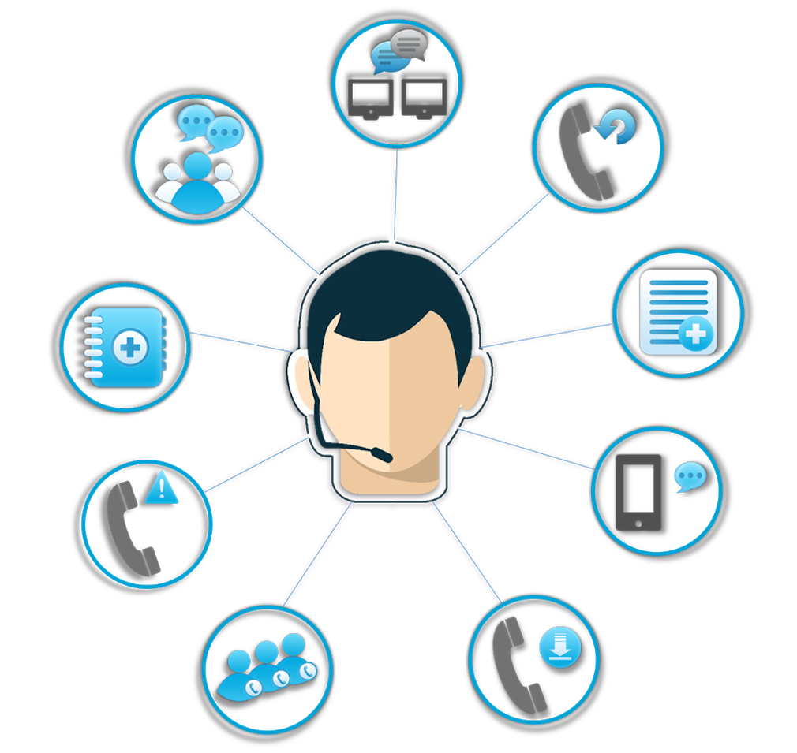


Design Thinking Reflection
Competitive Disadvantage
Current CMC
Employee Dissatisfaction
Customer Dissatisfaction

Slide 11
Travel Company
Airline Companies
How might we develop a high quality, technologically advanced CMC in a short timeline to ensure that more customers and employees do not leave the company, thus revitalising the business?
How might we be able to improve the reputation and increase the sales for the travel company in order to ensure high profits for Airline Companies?
How Might We Statements?
Developers
How might we ensure the developers are performing to the best of their ability whilst embodying all the desired features of the travel company?
Built from POV statements
Turn challenges into opportunities for design
System Admin
How might we utilise database queries and a new intuitive UI within the CMC to build a powerful toolkit for system administrators?
Customers
How might we might data with a new and improved CMC to deliver fast, accurate and personalised recommendations for our customers?
RMs
How might we be able improve the CMC so that RMs are able to fully utilise their expertise to create sales?

Slide 12

a spontaneous group discussion to produce ideas and ways of solving problems.
builds self-esteem because people are being asked for their participation and their ideas.
Brainstorm
builds involvement, commitment, loyalty, and enthusiasm
Participating in the sessions stimulates and unlocks people's creative talents

Slide 13
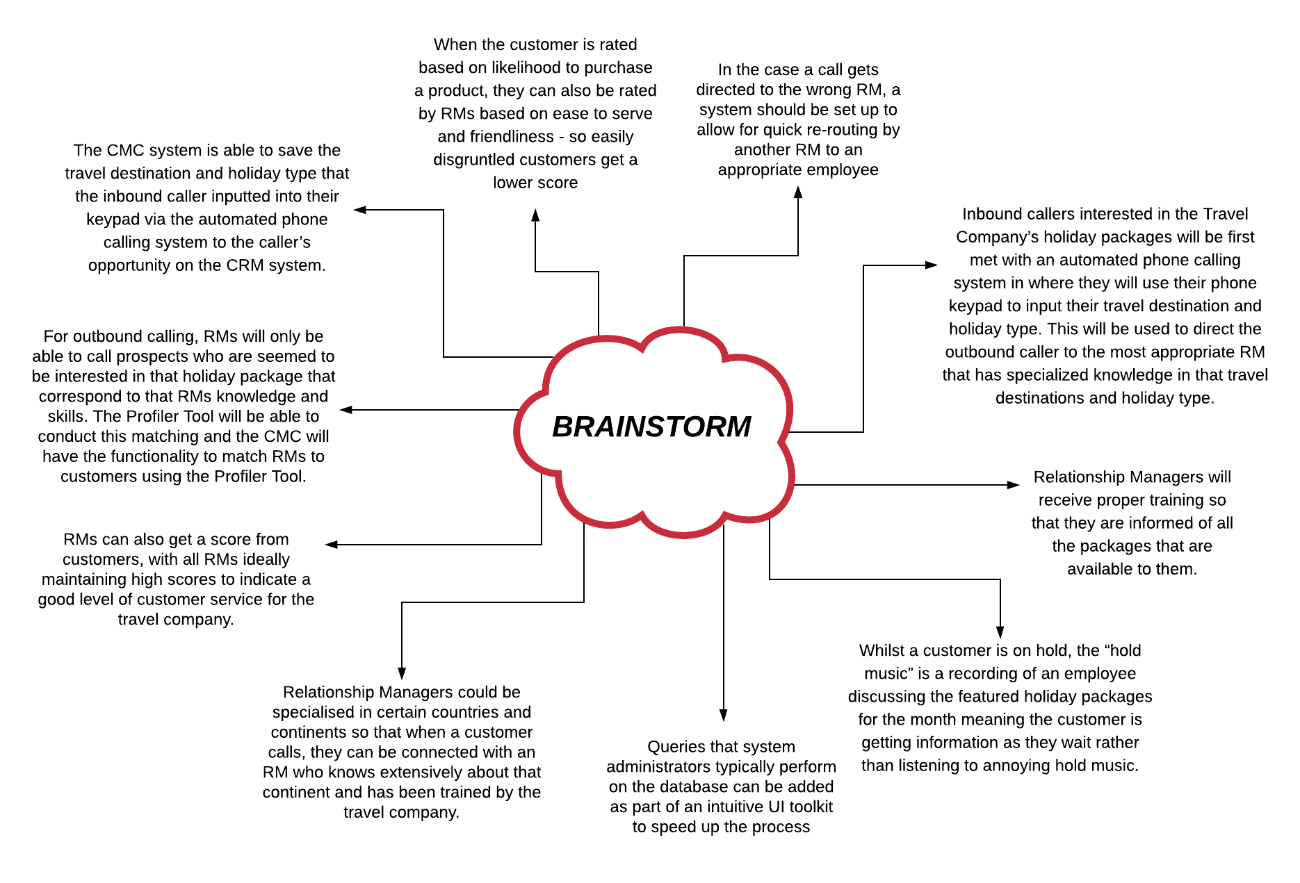

Slide 14






Vote
Most Likely To Succeed
Most Likely To Delight
Most Breakthrough
Whilst a customer is on hold, the “hold music” is a recording of an employee discussing the featured holiday packages for the month meaning the customer is getting information as they wait rather than listening to annoying hold music.
Inbound callers interested in the Travel Company’s holiday packages will be first met with an automated phone calling system in where they will use their phone keypad to input their travel destination and holiday type. This will be used to direct the outbound caller to the most appropriate RM.
Relationship Managers could be specialised in certain countries and continents so that when a customer calls, they can be connected with an RM who knows extensively about that continent and has been trained by the travel company.
Notes:
Most likely to success: We think this idea is the most practical and will provide the company the best opportunity to revitalise their business and
System.
Most breakthrough: This idea is the most breakthrough because it would stop RMs having to learn every single package and deal within the company. This would save a lot of money on training and it would give RMs the opportunity to truly understand the area of expertise which will help them provide excellent customer service.
Most likely to delight: Hold music often gets annoying for customers so we decided that this idea is the most “likely to delight” because it will replace the fuzzy music with informative holiday packages instead to help inform their decisions.

Slide 15
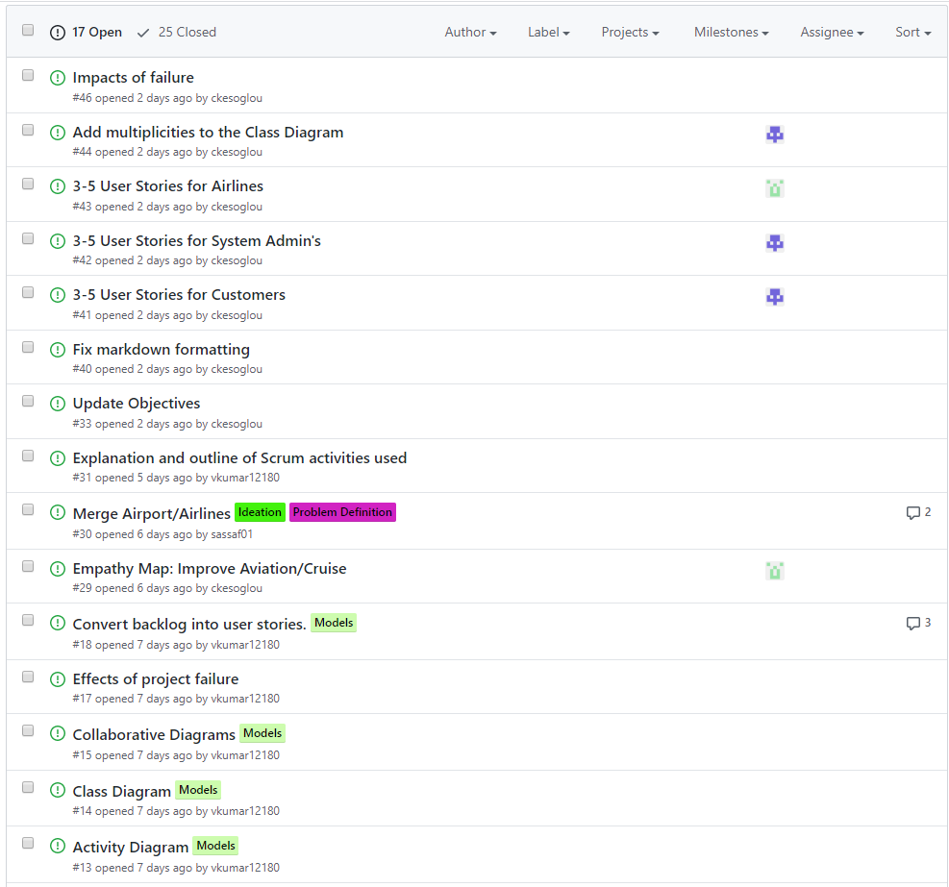
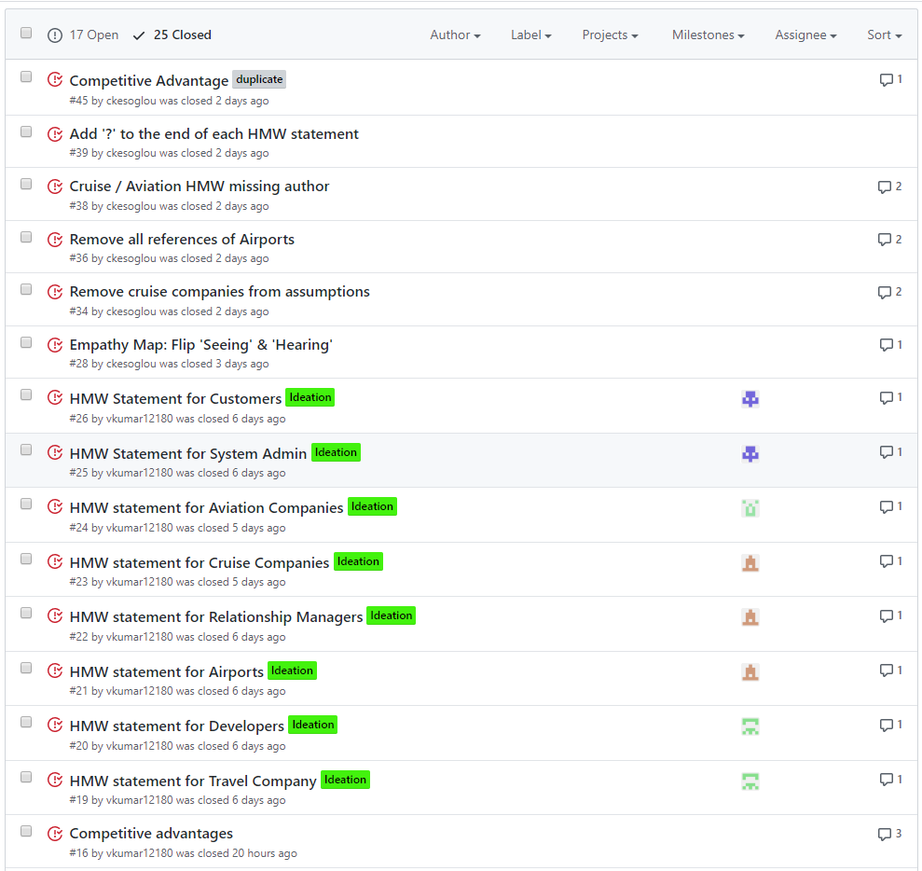
Issues Backlog
Notes:
Represents work to be done
Shown through our github

Slide 16
SEC 4 AND 5: DAN
Section 3: Prototyping & Modelling

Slide 17

User Stories
Travel Company
Relationship Managers
Customers
Developers
System Admin
Airline Companies
Travel Company
Relationship Managers
Customers
Developers
System Admin
Airline Companies

Slide 18
User Stories
AS A
TRAVEL COMPANY
I WANT
My employees to be thoroughly trained A new Call Management Centre system To have competitive prices on holiday packages within the market
To bring in new customers and more business
SO THAT
Employees are able to provide the best service to the business’ customers
We are able to revitalise our business by impressing customers
We are able to draw in customers to purchase packages from us
We are able to benefit our company alongside partnered airlines

Slide 19
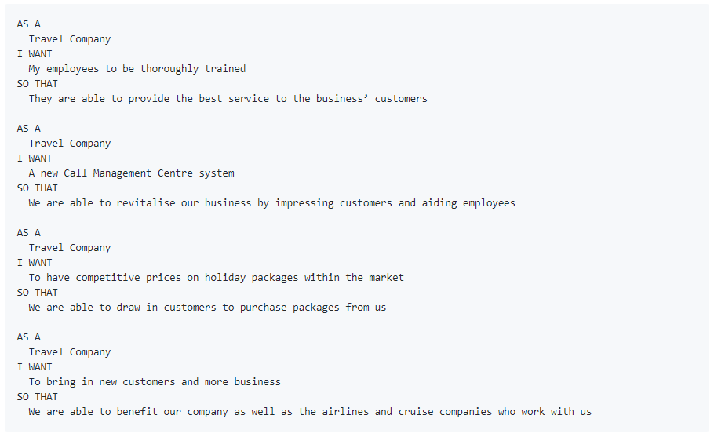
User Stories

Slide 20
User Stories
AS A
Customer
I WANT
To have travel and accommodation recommendations matched to my needs
To have my details and situation saved
My call to be routed and answered quickly
To be able to organise a call back time
SO THAT
I receive only relevant suggestions and can organise my holiday efficiently
I only need to explain it once and don't have to go through it again with every call
I'm not wasting a lot of time waiting on hold
I can fit this recommendation and booking process to my schedule

Slide 21
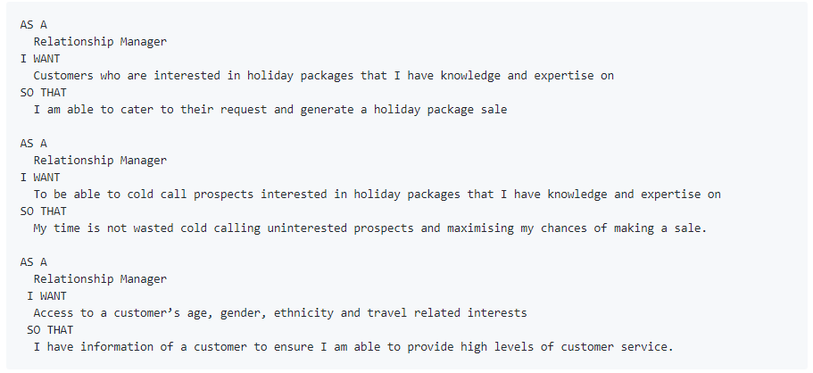
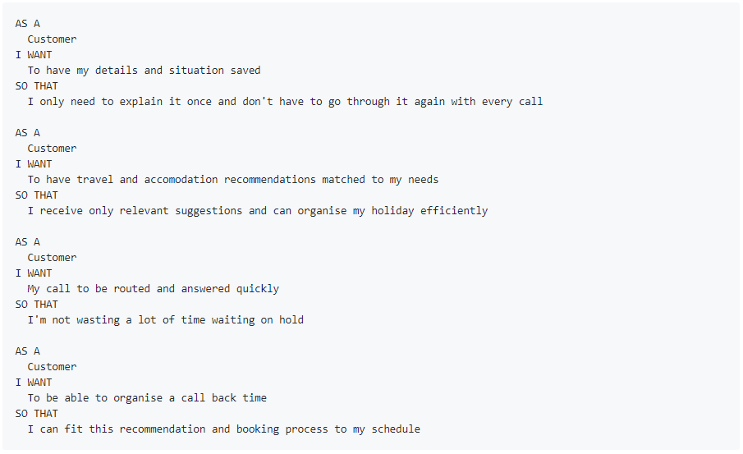
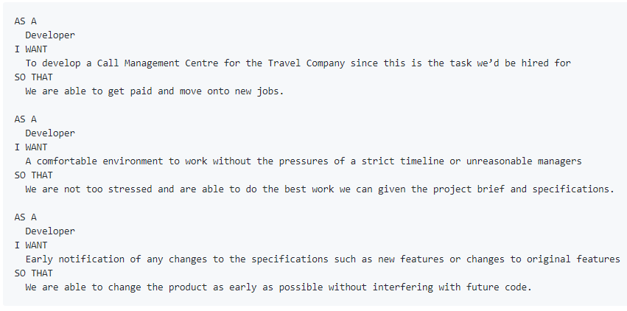
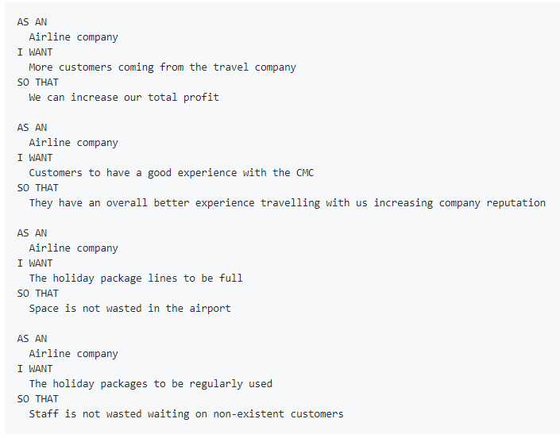
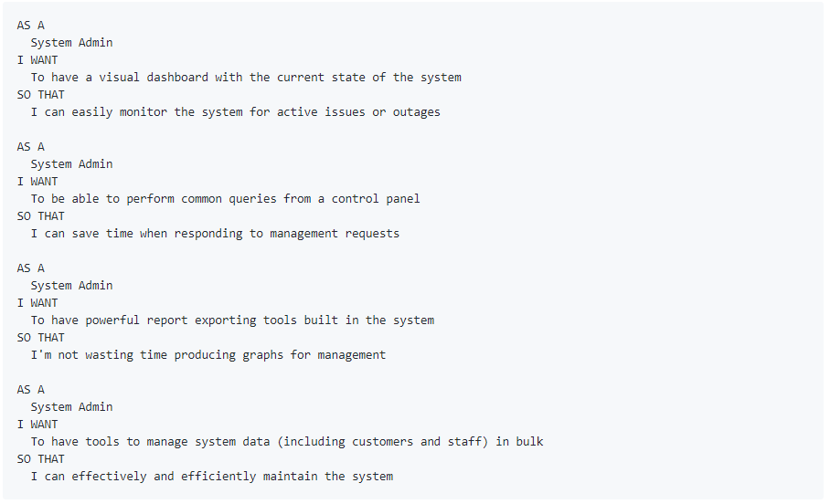
User Stories

Slide 22
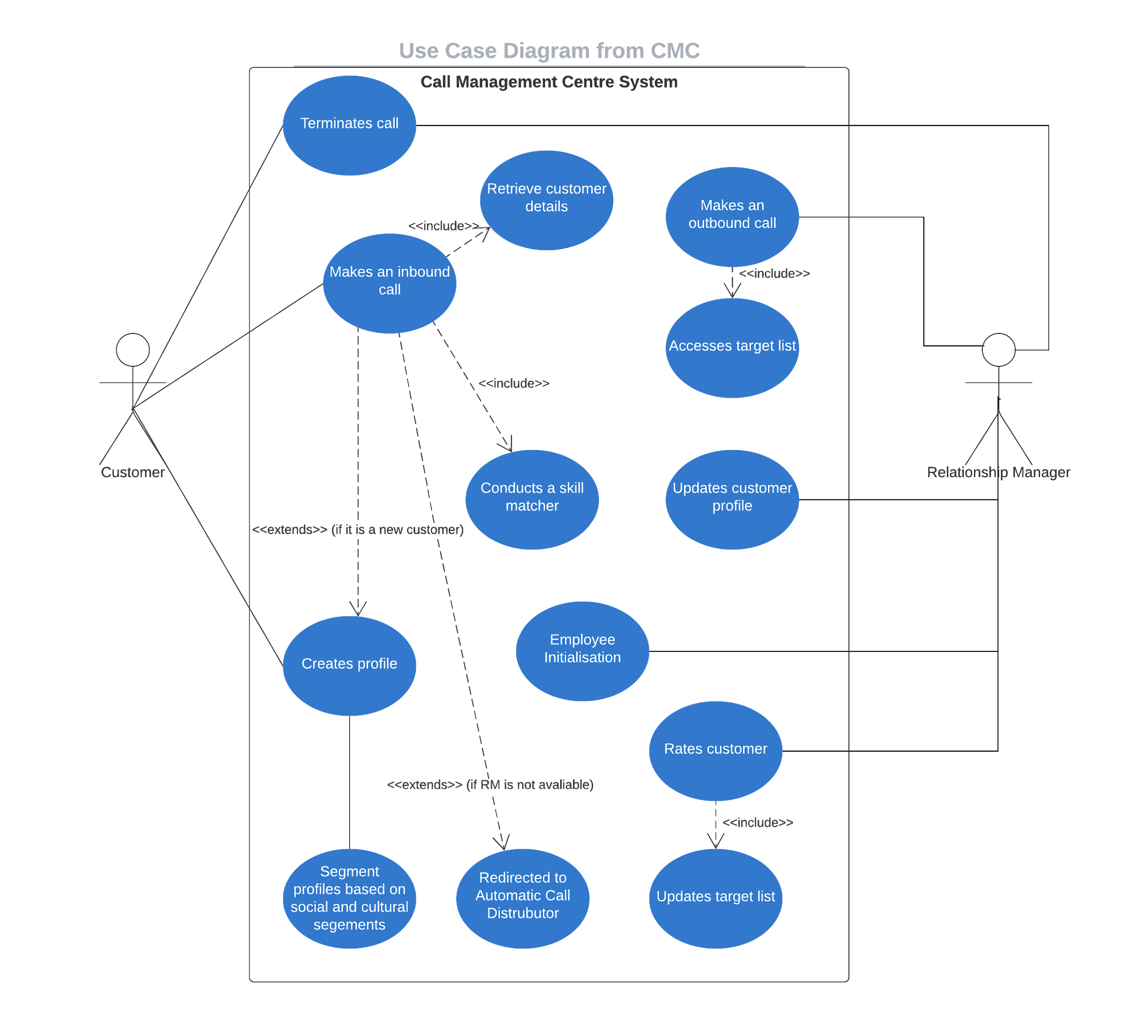

Slide 23
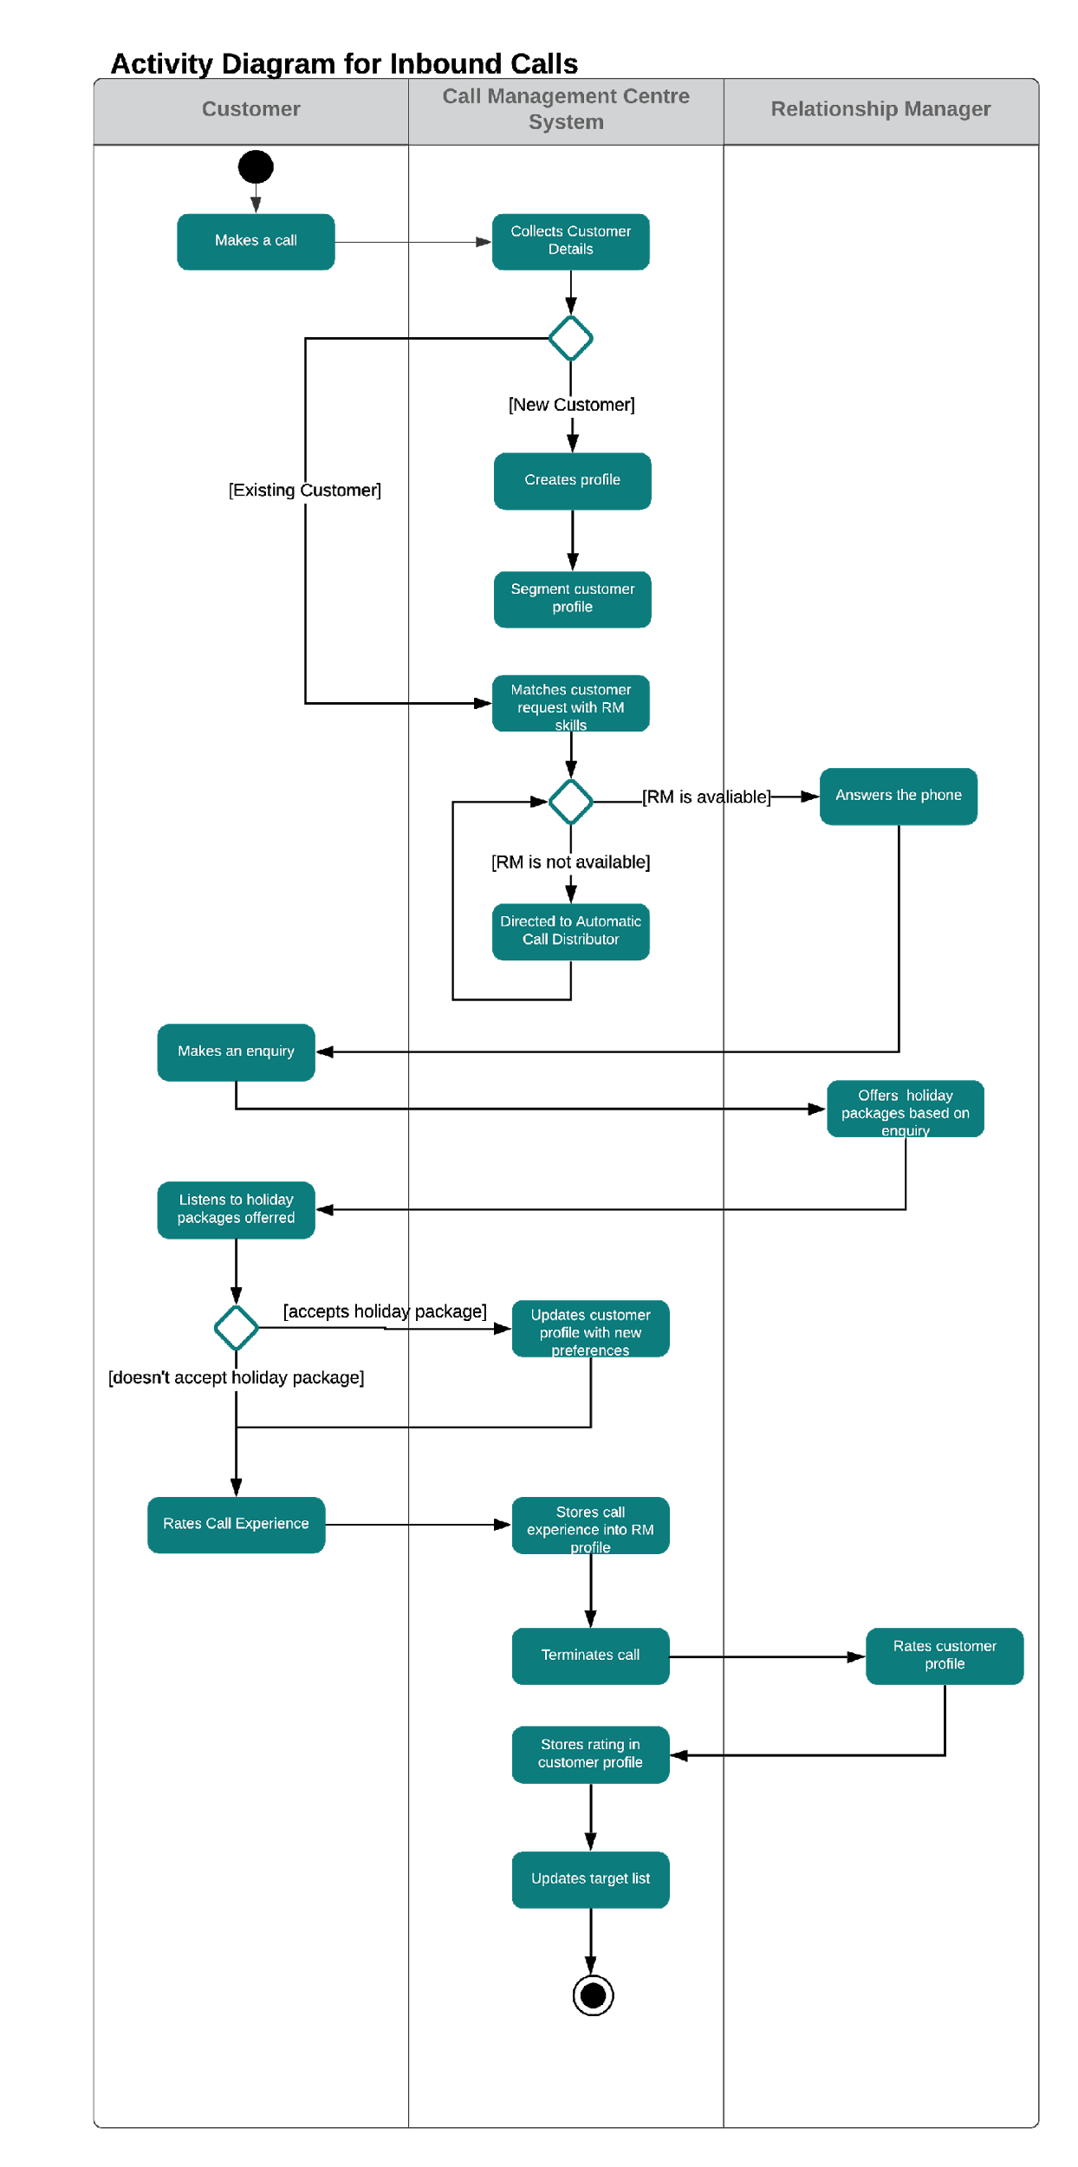
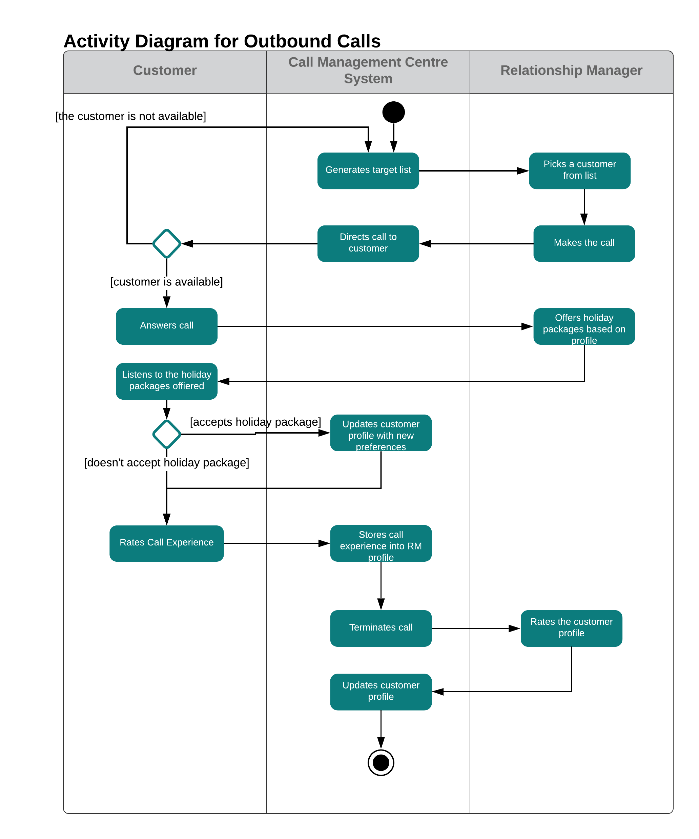

Slide 24
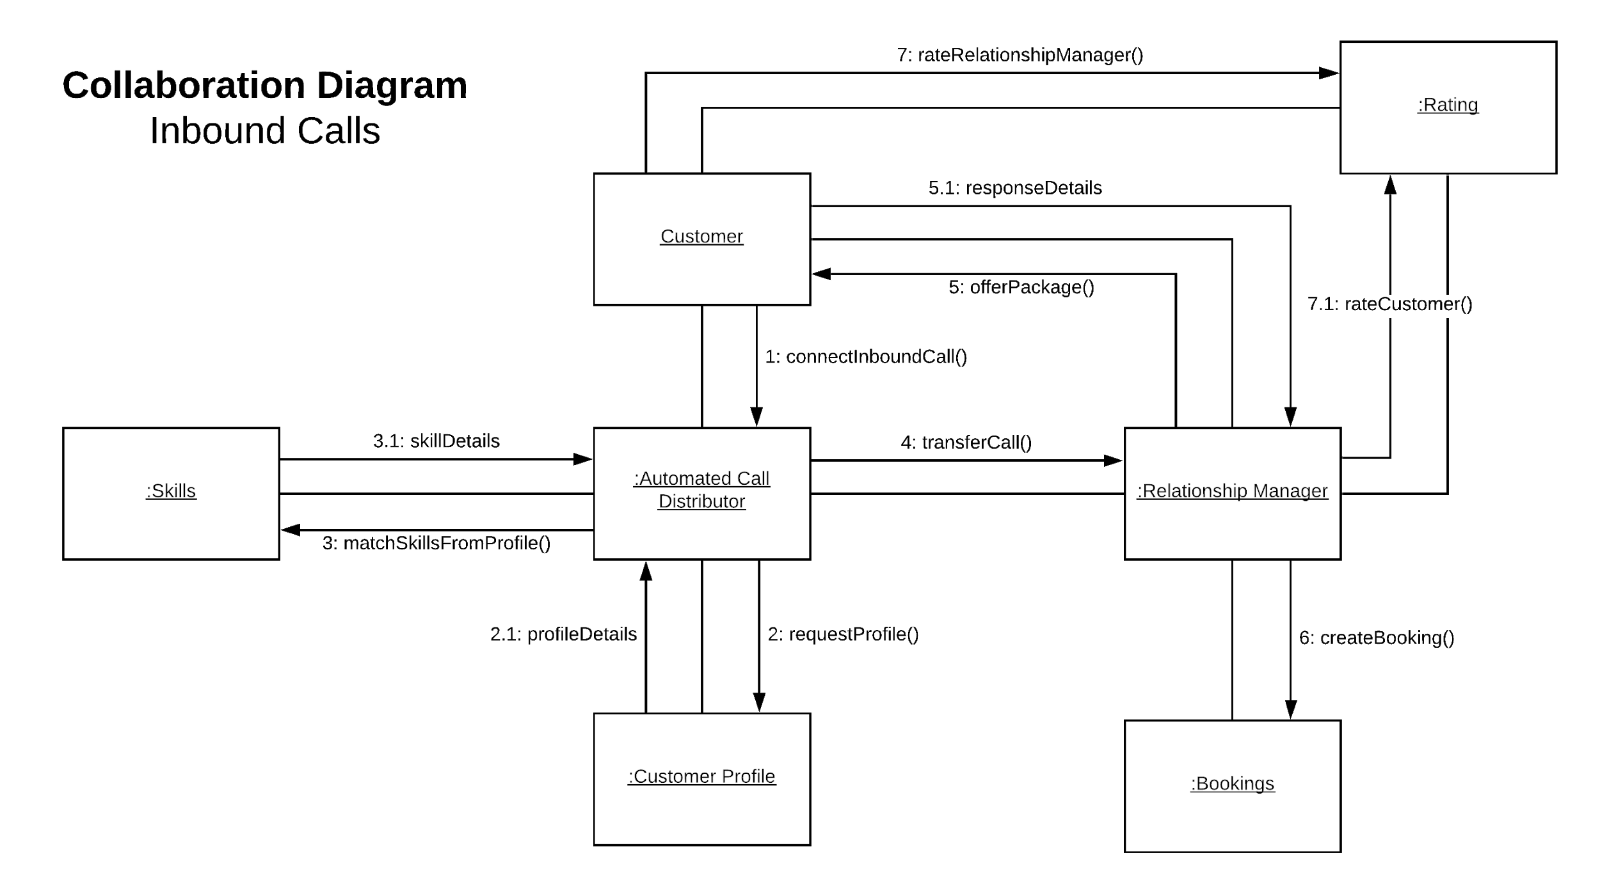

Slide 25
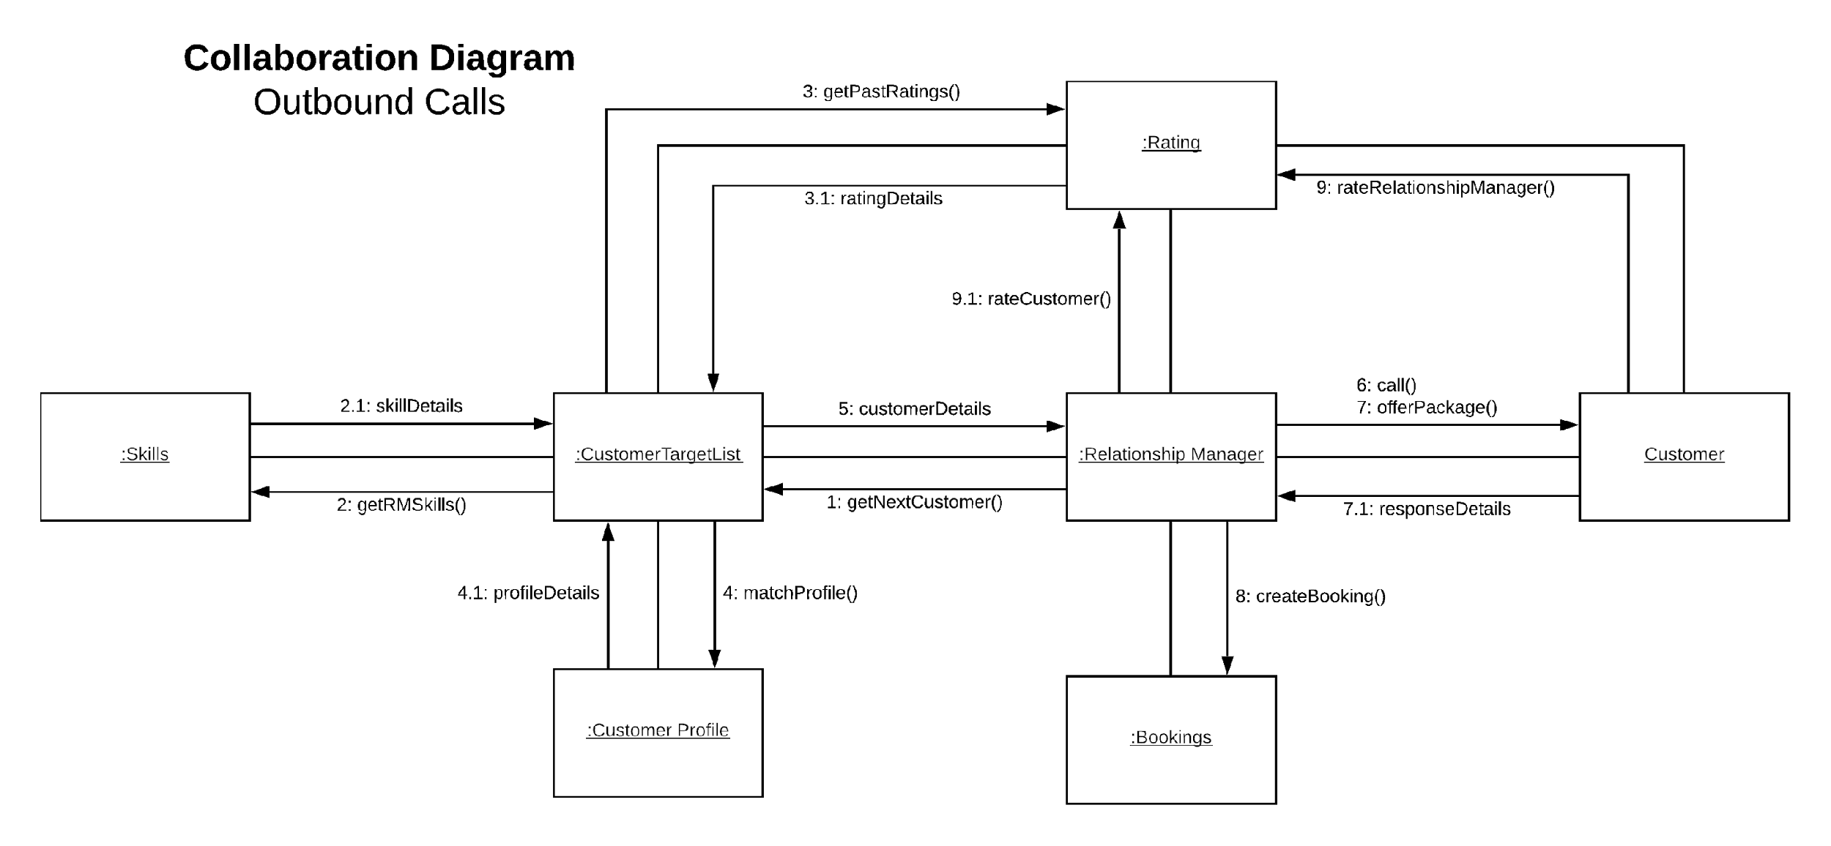

Slide 26
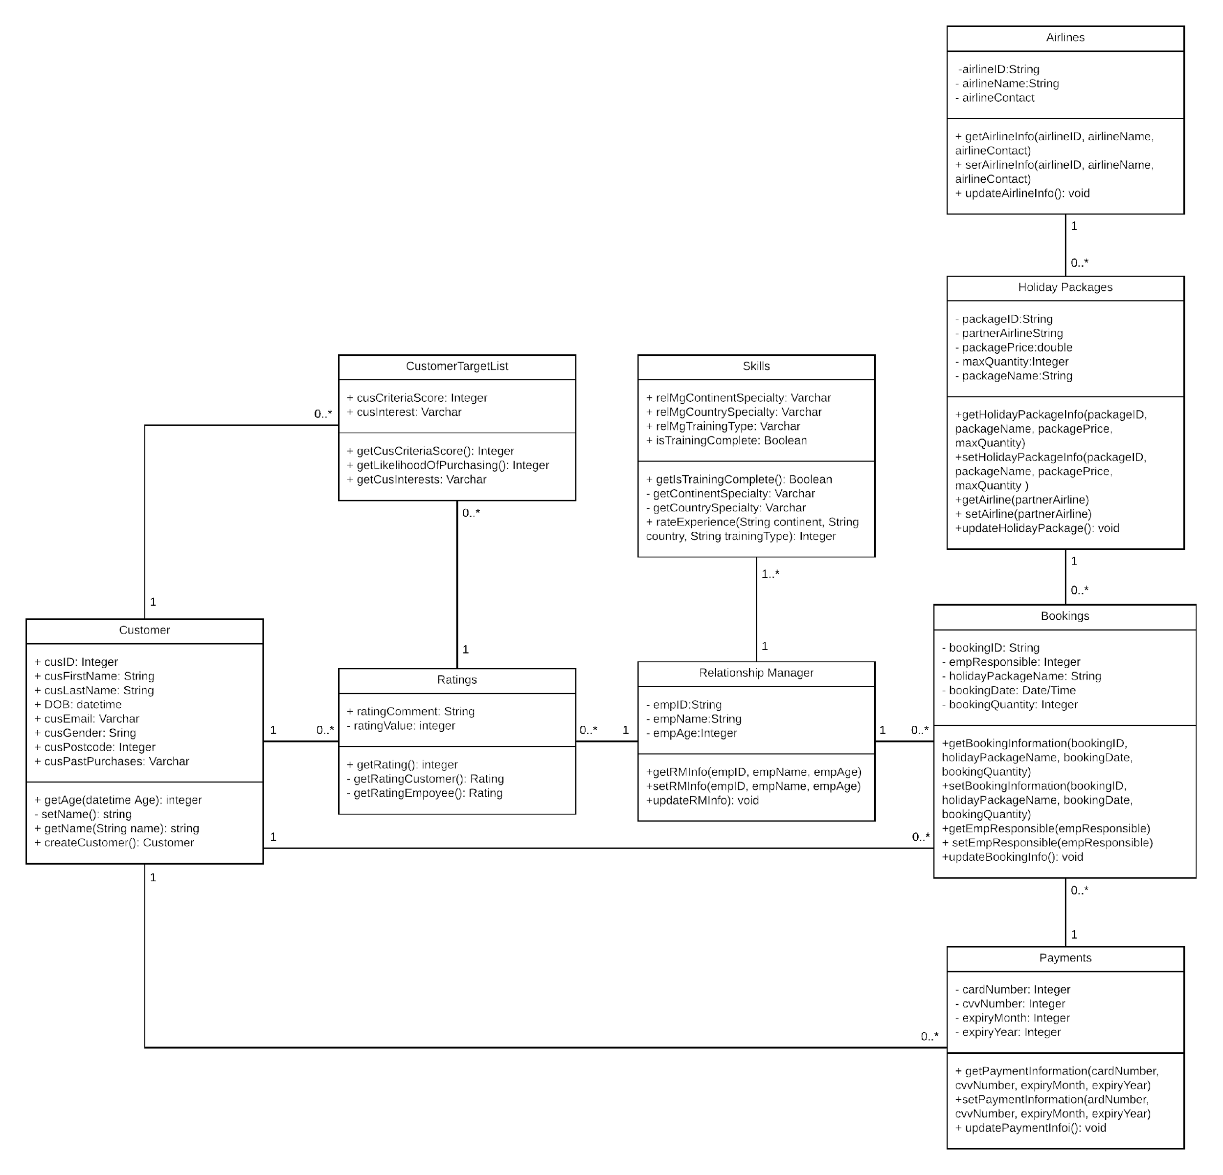
Class Diagram

Slide 27
SEC 4 AND 5: DAN
Section 4: Competitive Advantage

Slide 28



Competitive Advantage
Cheaper
Advantage
New CMC
Notes:
The new CMC will give a very good customer experience
Using the new automated matchmaking system the company can both lower cost and improve the experience for both customers and regional managers
Having personalised profiles for every past customer gives us a competitive edge over rival companies

Slide 29
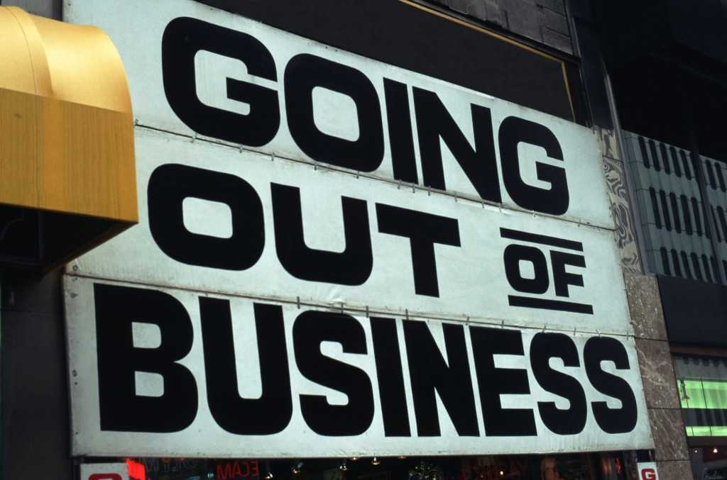


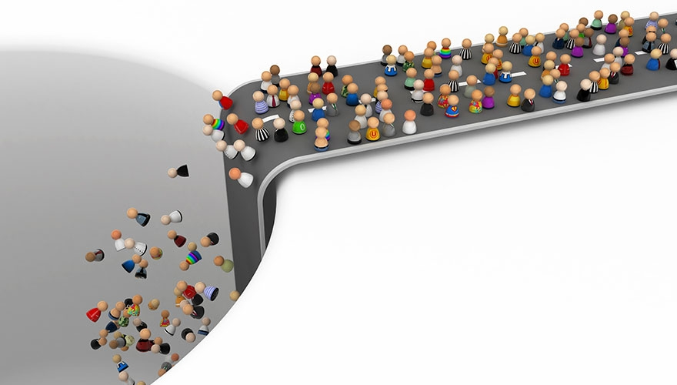
Impact of failure
Notes:
Travel Company will continue to lose customers with the confusing current system.
Since RMs work on commission, they will to leave the company as their will be no jobs and therefore no income
By losing employees and customers, the airlines will not be receiving any customers or revenue causing the relationship between the travel company and the airlines to fly away into the sunset never to be seen again.
the Travel Company will ultimately be forced to shut down since it will lose customers, employees and important professional relationships.

Slide 30
Section 5: Agile Methodology

Slide 31
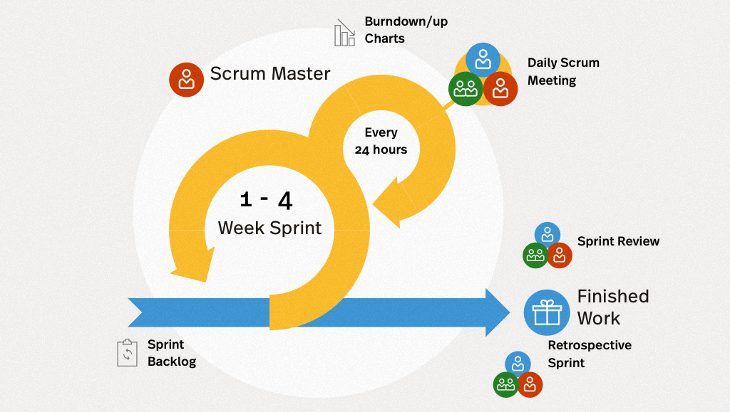
Agile
Notes:
Agile is a development methodology with many small iterations called sprints and in a smaller cross functional team, scrum is a form of agile methodology that incorporates sprints and roles, focusing on turning large projects into a series of smaller issues that are incrementally developed and completed to eventually create the completed large project.

Slide 32
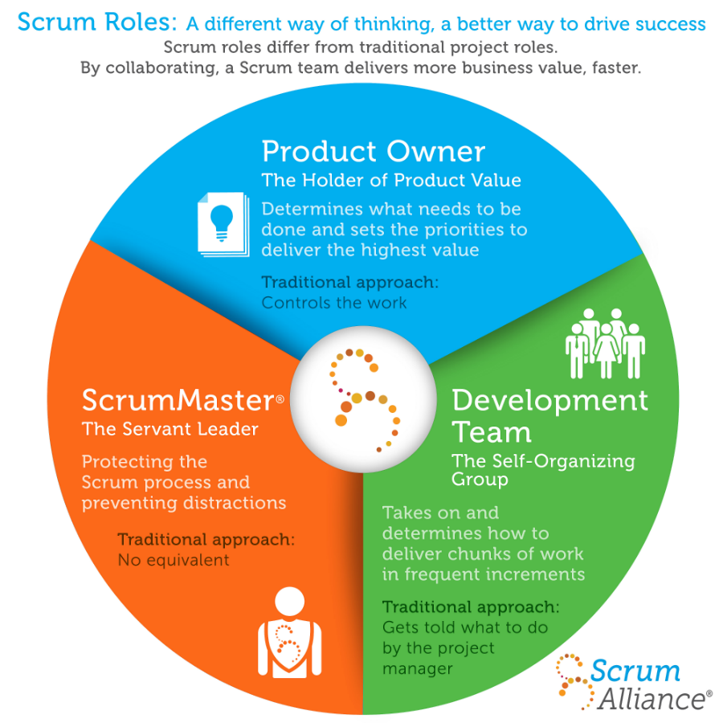
Scrum Roles
Notes:
There are many roles within the scrum process, and we had to act as all of them. Firstly, there is the product owner, we acted as the product owner using empathy maps and POV statements to understand the perspective of our stakeholders and determine what they were likely to most highly value. The role of the Scrum master was emulated through the use of github tools, creating issues to serve as a backlog to track what needed to be done and what was already completed. Finally we acted as the developer when assigning ourselves the issues in the backlog, working on and completing these issues.

Slide 33
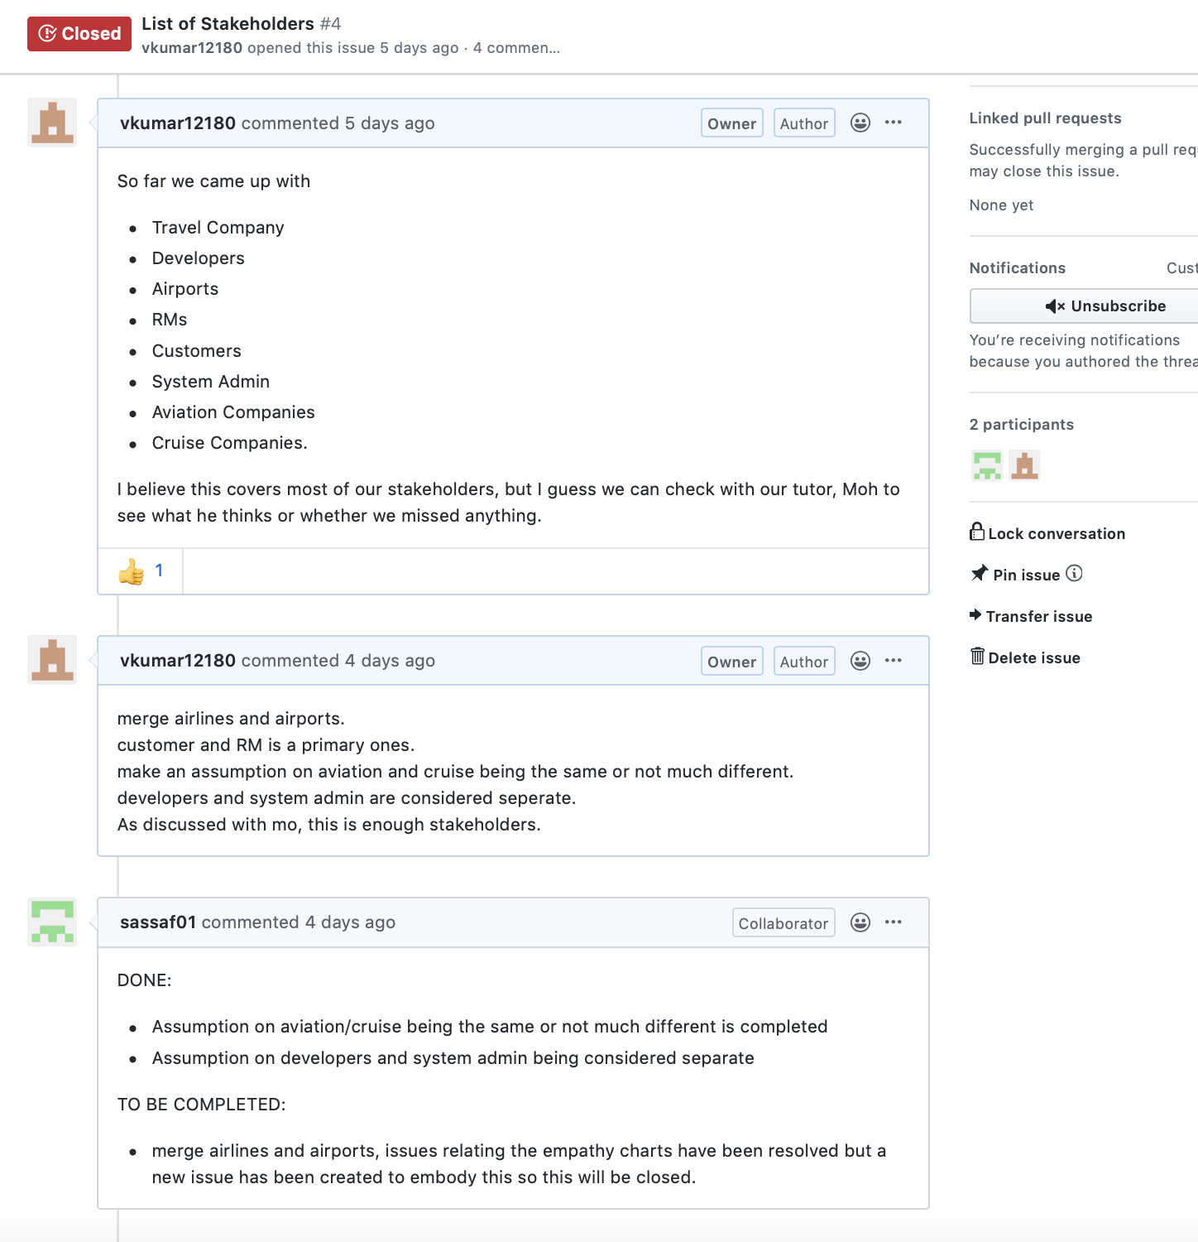
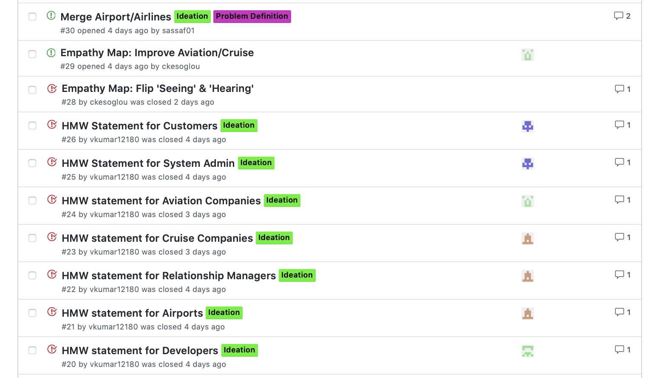
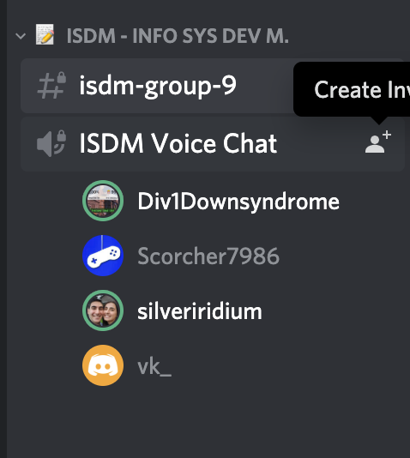
Evidence
Notes:
As you can see we had weekly calls on discord, ad were organising our issues on github, evenly assigning issues to each other and reviewing each other's work

